Slide 1
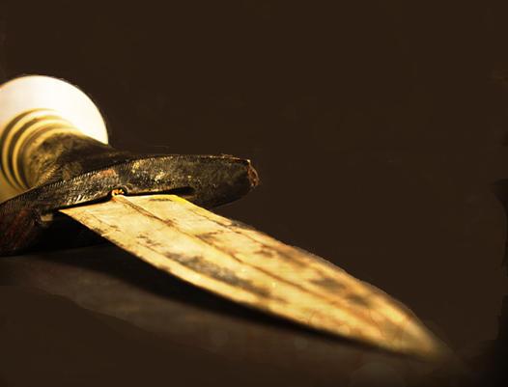
Preparation for God’s Rest Part 1: The Word of God
Hebrews 4:12-16
October 3, 2021

Slide 2
Hebrews 4:12-13
¹² For the word of God is living and active and sharper than any two-edged sword, and piercing as far as the division of soul and spirit, of both joints and marrow, and able to judge the thoughts and intentions of the heart. ¹³ And there is no creature hidden from His sight, but all things are open and laid bare to the eyes of Him with whom we have to do.

Slide 3
Hebrews 4:14-16
¹⁴ Therefore, since we have a great high priest who has passed through the heavens, Jesus the Son of God, let us hold fast our confession. ¹⁵ For we do not have a high priest who cannot sympathize with our weaknesses, but One who has been tempted in all things as we are, yet without sin. ¹⁶ Therefore let us draw near with confidence to the throne of grace, so that we may receive mercy and find grace to help in time of need.

Slide 4
Preparation to Enter God’s Rest
Three part series
I. The Word of God (4:12-13)
II. The Son of God (4:14-15)
III. The Grace of God (4:16)

Slide 5
I. The Word will Accomplish its task (4:12)
¹² For the word of God is living and active and sharper than any two-edged sword
A. The Word is alive (4:12a)
¹² For the word of God is living and active
Energes – Where we get our English word energy and from 2 root words.
En – meaning within
Ergon meaning work or activity

Slide 6
2 Timothy 3:16-17
¹⁶ All Scripture is inspired by God and profitable for teaching, for reproof, for correction, for training in righteousness; ¹⁷ so that the man of God may be adequate, equipped for every good work.
“Inspired”
Theo meaning God
Pneustos meaning breathed into

Slide 7
John 11:41-44
⁴¹ So they removed the stone. Then Jesus raised His eyes, and said, “Father, I thank You that You have heard Me. ⁴² I knew that You always hear Me; but because of the people standing around I said it, so that they may believe that You sent Me.” ⁴³ When He had said these things, He cried out with a loud voice, “Lazarus, come forth.” ⁴⁴ The man who had died came forth, bound hand and foot with wrappings, and his face was wrapped around with a cloth. Jesus *said to them, “Unbind him, and let him go.”

Slide 8
I. The Word will Accomplish its task (4:12)
¹² For the word of God is living and active and sharper than any two-edged sword
A. The Word is alive (4:12a)
B. The Word is sharp (4:12b)
And sharper than any two-edged sword

Slide 9
2 Corinthians 7:8-9
⁸ For though I caused you sorrow by my letter, I do not regret it; though I did regret it—for I see that that letter caused you sorrow, though only for a while— ⁹ I now rejoice, not that you were made sorrowful, but that you were made sorrowful to the point of repentance; for you were made sorrowful according to the will of God, so that you might not suffer loss in anything through us.

Slide 10
II. The Word is Accurate (4:12)
And piercing as far as the division of soul and spirit, of both joints and marrow, and able to judge the thoughts and intentions of the heart.
A. The Word is Penetrating (12c)
And piercing as far as the division of soul and spirit, of both joints and marrow

Slide 11
II. The Word is Accurate (4:12)
And piercing as far as the division of soul and spirit, of both joints and marrow, and able to judge the thoughts and intentions of the heart.
A. The Word is Penetrating (12c)
B. The Word is Discerning (12d)
And able to judge the thoughts and intentions of the heart.
“Judge” – Kritikos – meaning critical or critic, in adjective form, it means to exercise judgment or to be discerning.
“Heart” – Kardias – thoughts and intentions of the heart.

Slide 12
III. The Word will Anatomize (4:13)
And there is no creature hidden from His sight but all things are open and laid bare to the eyes of Him with whom we have to do.
A. The Word reveals God to us (13a)
And there is no creature hidden from His sight
1. The Omniscience of God

Slide 13
Psalm 19:1-2
¹ The heavens tell of the glory of God; And their expanse declares the work of His hands. ² Day to day pours forth speech, And night to night reveals knowledge.

Slide 14
Proverbs 15:3
The eyes of the Lord are in every place, watching the evil and the good.

Slide 15
III. The Word will Anatomize (4:13)
And there is no creature hidden from His sight but all things are open and laid bare to the eyes of Him with whom we have to do.
A. The Word reveals God to us (13a)
And there is no creature hidden from His sight
1. The Omniscience of God
2. The Omnipresence of God

Slide 16
III. The Word will Anatomize (4:13)
And there is no creature hidden from His sight but all things are open and laid bare to the eyes of Him with whom we have to do.
A. The Word reveals God to us (13a)
B. The Word reveals us to us (13b)
But all things are open and laid bare to the eyes of Him with whom we have to do.
1. The sin that remains
But all things are open and laid bare to the eyes of Him

Slide 17
Psalm 139:23-24
²³ Search me, God, and know my heart; Put me to the test and know my anxious thoughts; ²⁴ and see if there is any hurtful way in me, And lead me in the everlasting way.

Slide 18
III. The Word will Anatomize (4:13)
And there is no creature hidden from His sight but all things are open and laid bare to the eyes of Him with whom we have to do.
A. The Word reveals God to us (13a)
B. The Word reveals us to us (13b)
But all things are open and laid bare to the eyes of Him with whom we have to do.
1. The sin that remains
2. The true motives of the heart

Slide 19
Preparation for God’s Rest Part 1: The Word of God
Hebrews 4:12-16
October 3, 2021

